Slide 1
HTML5 Advanced Topics
Ci-Wei Lan 藍啟維
Dept. of CSE, NTOU

Slide 2
Outlines
Interactive Control - Information Submission from Users
HTML5 Form input Types and input validation

Slide 3
Information Collection Element ─ <form>
The method attribute: specifies how the form’s data is sent.
  method="post" (for creating & submitting data)
    appends form data to the browser request, which contains the protocol (HTTP) and the requested resource’s URL.
  method="get" (for navigating & retrieving data)
    appends the form data directly to the end of the URL of the script, where it’s visible in the browser’s Address field.
  method=”dialog” (for closing pop-up modals natively)
    When the form is inside a <dialog>, closes the dialog and causes a submit event to be fired on submission, without submitting data or clearing the form.
The action attribute: specifies the script to which the form data will be sent.
  Can be server-/client-side scripts

Slide 4
GET vs POST Method Comparisons
Feature | GET | POST
Semantics | Retrieve / Query | Create / Submit
Data Location | URL query string | Request body
Cacheability | Can be cached | Not cached
Shareability | Easy to copy/share URL | Not easily shareable
Data Size | Limited by browser/server (≈2,000~8,000 characters) | Practically unlimited (often up to several GB, depending on server settings)
Security | Not suitable for sensitive data | Suitable for sensitive or large data

Slide 5
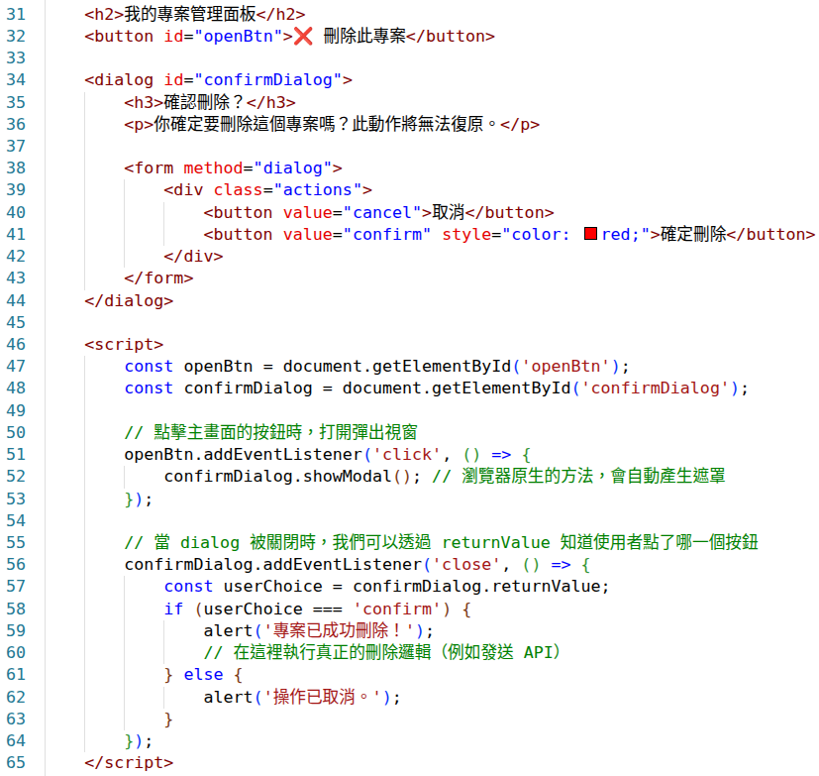
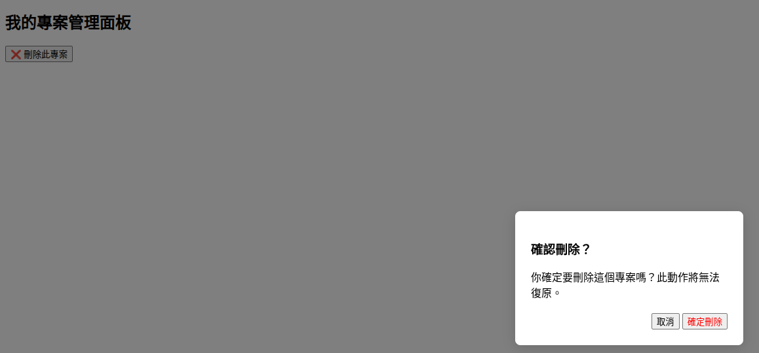
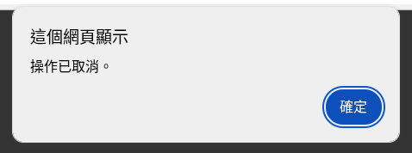
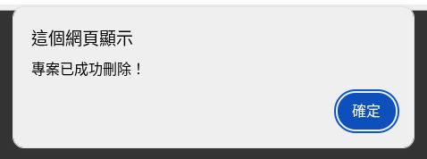
An Example of <form method=”dialog”>

Slide 6
Accept Data Element ─ <input>
A wide variety of types of input data and control widgets are available, depending on the device and user agent.
  An input’s type is determined by its type attribute.
  The autofocus attribute: an optional attribute that can be used in only one input element in a form—automatically gives the focus to the input element, allowing the user to begin typing in that element immediately.
  The required attribute: An input value is required or must be checked for the form to be submittable.
Non-visual components (a specific type of input), called hidden inputs, store any data that you specify, such as e-mail addresses and HTML5 document file names that act as links.

Slide 7
Text Input Element ─ <input type=”text”>
<input type=”text”> elements creates basic single-line text fields.
  Learn multi-line text fields with <textarea> element.
The size attribute specifies the number of characters visible in the text field.
The maxlength attribute limits the number of characters input into a text field.
The placeholder attribute is a string that provides a brief hint to the user as to what kind of information is expected in the field.

Slide 8
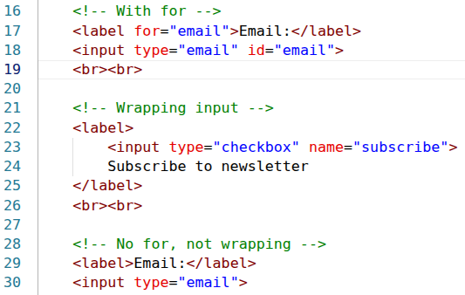
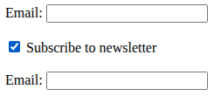
Input Caption Element ─ <label>
The <label> element represents a caption for an item in a user interface.
Associating a label with a form control:
  Enclosing <input> elements or set attribute for and its value identical to the id of corresponding <input> element.
  Effect: the focus is automatically move on the input element when click on <label> display.

Slide 9
Form Submission and Reset Types
The submit input element is a button: <input type=”submit”>
  When the submit button is pressed, the form’s data is sent to the location specified in the form’s action attribute.
The reset input element is a button: <input type=”reset”>
  Allows a user to reset all form elements to their default values.
The value attribute sets the text displayed on the buttons.

Slide 10
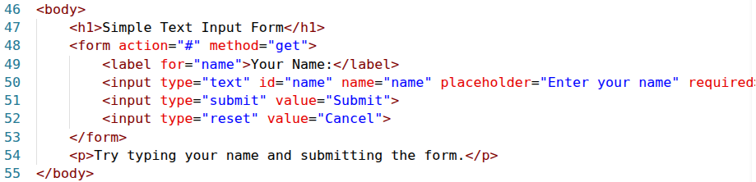
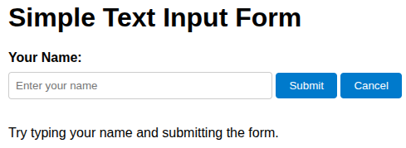
An Example of Text Input Form

Slide 11
HTML5 Input Types

Slide 12
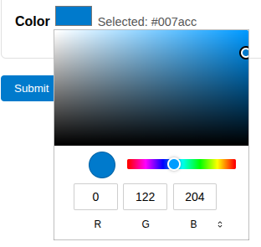
Input Element ─ <input type=”color”>
A color picker is displayed for selected color. (most browsers support this already)
  Ensure the input value is valid.
  Better user experiences than textual input (User can see the color by selection).

Slide 13
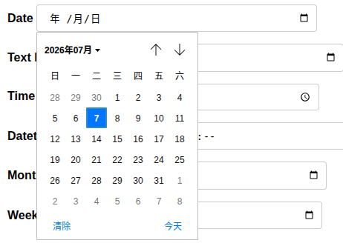
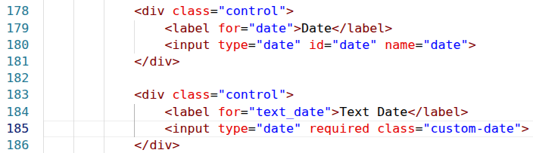
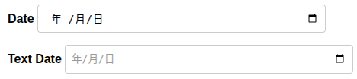

Input Element ─ <input type=”date”>
Enables the user to enter a date in the form yyyy-mm-dd.
  A text field, user can enter a date such as 2012-01-27.
  A spinner control—a text field with an up-down arrow () on the right side—allowing the user to select a date by clicking the up or down arrow.
  The start date is the local and current date.

Slide 14

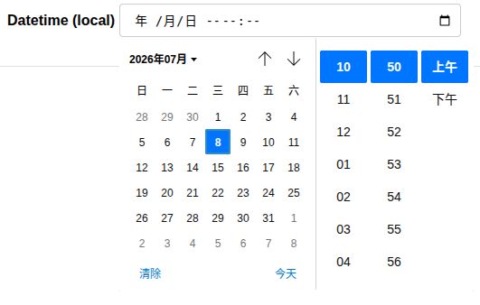
Input Element ─ <input type=”datetime-local”>
Enables the user to enter the date and time in a single control.
  The data is entered as year, month, day, hour, minute, second and fraction of a second.
  The date time is the local timezone.

Slide 15

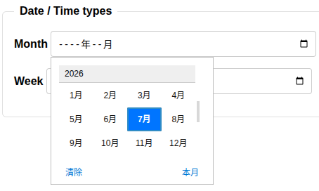
Input Element ─ <input type=”month”>

Slide 16

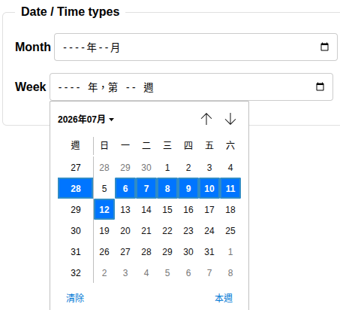
Input Element ─ <input type=”week”>

Slide 17
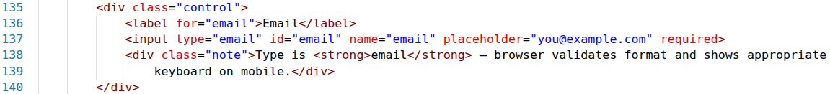
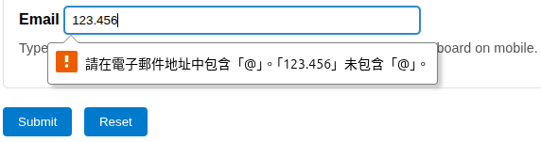
Input Element ─ <input type=”email”>
Enables the user to enter an e-mail address.
  A list of e-mail addresses separated by commas (if the multiple attribute is specified).
Though text field appearance, browsers do implement validation check of input when submit button is clicked. (Validation only, no verification).
To bypass the validation, add formnovalidate attribute in submit input element.

Slide 18
Input Element ─ <input type=”number”>
Enables the user to enter a numerical value—mobile browsers typically display a numeric keypad for this input type.
  The min/max attribute sets the minimum/maximum valid number.
  The step attribute determines the increment.
  The value attribute sets the initial value.
A validation check is conducted when clicking submit button.

Slide 19
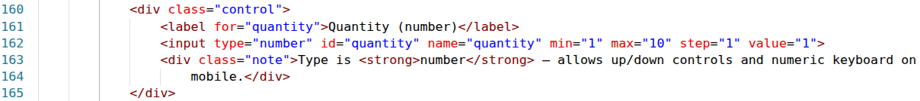
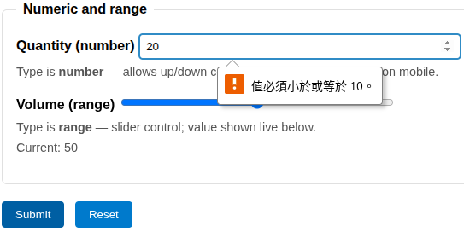
An Example of <input type=”number”>

Slide 20
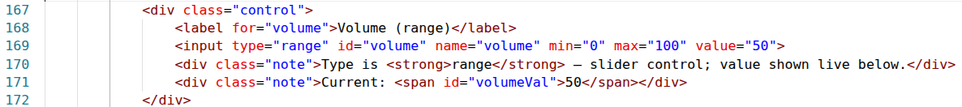

Input Element ─ <input type=”range”>
Appears as a slider control.
  The min/max attribute sets the minimum/maximum valid number.
  Self-validation.

Slide 21

Input Element ─ <input type=”search”>
Provides a search field for entering a query functionally equivalent to an input of type text except for a clear feature by cross sign when any input is given.

Slide 22
Input Element ─ <input type=”tel”>
Enables the user to enter a telephone number—mobile browsers typically display a keypad specific to entering phone numbers for this input type.
HTML5 does not self validate the tel input type. Using the pattern attribute (with value of regular expression) for the purpose.
  . # Matches any single character.
  [ ] # Matches a single character that is contained within the brackets.
  ( ) # Groups expressions to assist in alternation and back referencing.
  ^ # Matches the starting position within the string.
  $ # Matches the ending position of the string or the position just before a string-ending newline.
  https://developer.mozilla.org/zh-TW/docs/Web/JavaScript/Guide/Regular_expressions

Slide 23
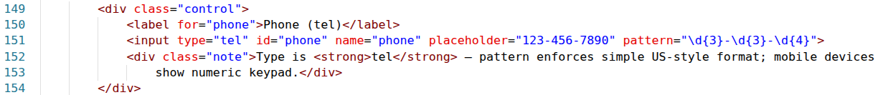
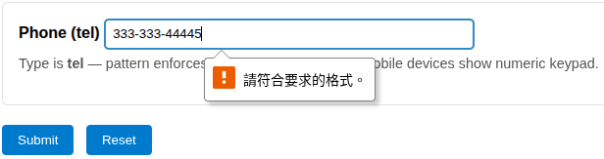
An Example of <input type=”tel”>

Slide 24
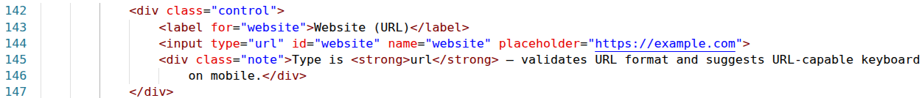
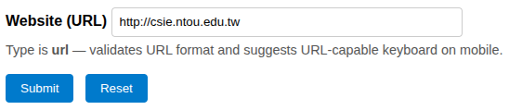
Input Element ─ <input type=”url”>
Enables the user to enter a URL.
Though text field appearance, browsers do implement validation check of input when submit button is clicked. (Validation only, no verification).

Slide 25
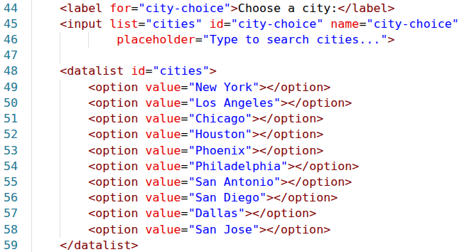
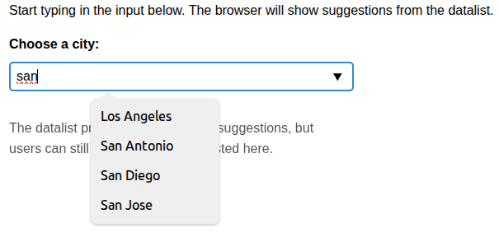
Datalist Element ─ <datalist>
Provides input options and contains a set of <option> elements that represent the permissible or recommended options available to choose from.
Paired with <input> element.
  The value of list attribute of input element should be identical to the value of id attribute of datalist element.

Slide 26
File Upload Element ─ <input type=”file”>
Let the user choose one or more files from their device storage.
The accept attribute defines the file types the input should accept. comma-separated list for multiple types are allowed.
The capture attribute value is a string that specifies which camera to use for capture of image or video data.
  A value of user indicates that the user-facing camera and/or microphone should be used.
  A value of environment specifies that the outward-facing camera and/or microphone should be used.
When the multiple Boolean attribute is specified, the file input allows the user to select more than one file.

Slide 27
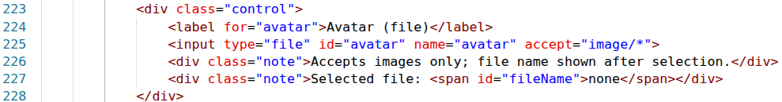

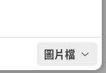
An Example of File Upload Element

Slide 28
Try it Yourself ─ Form Input Practices
Play around more input types and corresponding attributes
  Single and multiple choices.
    https://developer.mozilla.org/en-US/docs/Web/HTML/Reference/Elements/input
  Drop down list
    https://developer.mozilla.org/en-US/docs/Web/HTML/Reference/Elements/select

Slide 29

Questions?

